Slide 1

Forecasting Air Quality Index: A Machine Learning Odyssey
Anand Vishant
Under The Guidance Of:
Professor Goettsch

Slide 2
Table of contents
01
Introduction
02
Importance Of Air Quality Analysis
03
Hypotheses
04
Research Methodology
05
Skill development
06
Conclusion

Slide 3
Project & Strategy
01

Slide 4
Introduction
Focus: Air Quality Analysis and Prediction, a critical field in environmental science and public health research.
Importance: Addressing environmental concerns and their impact on public health due to air quality.
Interdisciplinary Approach: Merging environmental science, data science, and machine learning to understand air quality dynamics comprehensively.
Objective: Predicting the Air Quality Index (AQI) to assess air pollution levels.
Policy Impact: Enabling effective decision-making by policymakers, urban planners, and public health authorities.
Core Elements: Involving data collection, machine learning techniques, and evaluation metrics for robust air quality predictions.

Slide 5
Importance of air quality analysis
Human Health: Poor air quality leads to a myriad of health issues, including respiratory and cardiovascular diseases. It's not just a matter of discomfort; it's a matter of life and death.
Environmental Impact: Air pollution is a significant contributor to climate change, affecting the planet's long-term health and stability.
Public Health Decision-Making: Accurate air quality analysis is essential for public health authorities and policymakers. It informs decisions and strategies to mitigate the harmful effects of air pollution.
Comprehensive Understanding: Our interdisciplinary research merges environmental science, data science, and machine learning to provide a comprehensive understanding of air quality dynamics.

Slide 6
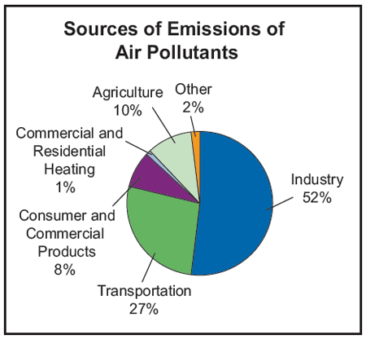

Slide 7
Hypotheses
Hypothesis 1: Effective AQI Level Prediction by Machine Learning Models
Prediction Objective: Forecasting AQI levels accurately
Methodology:
Utilizing historical air quality data
Incorporating relevant environmental variables
Training and validation of machine learning models
Expected Outcome:
Accurate prediction of AQI, a vital metric for air pollution assessment
Capture of complex relationships and patterns within the dataset

Slide 8
Hypotheses Contd.
Hypothesis 2: Increasing Predictive Accuracy by Including a Variety of Environmental Parameters
Prediction Enhancement:
Incorporating a wide range of environmental factors
Parameters include pollutant concentrations and weather conditions
Factors like temperature, humidity, wind speed, and direction
Methodology:
Expanding the scope of data collection
Integrating environmental data into machine learning models
Considering complex dynamics of air quality
Expected Outcome:
Improved predictive accuracy in AQI
Enhanced ability to capture the intricate factors influencing air quality

Slide 9
Hypotheses Contd.
Hypothesis 3: Machine Learning Models Perform Better Than Conventional Methods
Performance Expectation:
Machine learning models outperform conventional statistical techniques
Superior handling of complex, nonlinear relationships
Adaptation to changing environmental conditions
Key Advantages:
Capability to handle intricate, non-linear data patterns
Flexibility to adapt to evolving environmental dynamics
Efficient handling of extensive datasets
Expected Outcomes:
Improved accuracy and reliability in AQI prediction
Enhanced capability to address the challenges of air quality analysis

Slide 10
Hypotheses Contd.
Hypothesis 4: Location and Seasonal Variations Affect Model Performance
Performance Variation:
Anticipated spatial and temporal variations in model performance
Dynamics of air quality vary across regions
Model efficacy influenced by seasonal changes
Factors Impacting Performance:
Regional differences in pollutant levels
Seasonal patterns in weather conditions
The need for region-specific model adaptations
Expected Outcomes:
Recognition of performance disparities across geographic regions
Understanding the influence of seasons on model effectiveness

Slide 11
Hypotheses Contd.
Hypothesis 5: Evaluative Metrics Confirm Model Reliability
Reliability Validation:
Utilizing evaluation metrics for model substantiation
Metrics include Mean Absolute Error (MAE), Root Mean Square Error (RMSE), and Correlation Coefficients
Quantifying the accuracy and reliability of AQI predictions
Metric Significance:
MAE and RMSE for error assessment
Correlation coefficients for relationship strength
Assurance of model effectiveness in practical applications
Expected Confirmation:
Clear validation of machine learning model performance
Assurance of model reliability for real-world air quality applications

Slide 12
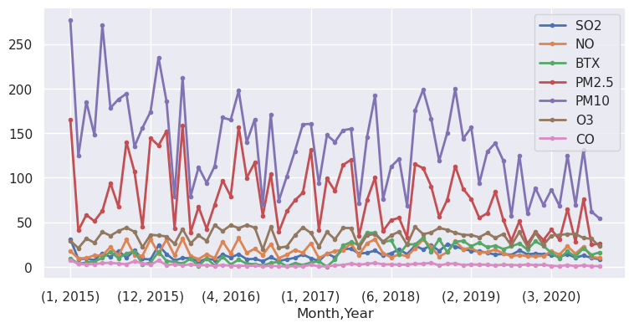
Air Quality Trends

Slide 13
Research Methodology
02

Slide 14
Research Methodology-Data Source and Gathering
Primary Data Source:
The Environmental Protection Agency (EPA)
Other publicly accessible environmental monitoring organizations
Data Composition:
Historical records for meteorological, geographic, and air quality parameters
Comprehensive and diverse dataset
Temporal and Geographic Span:
Data collected over various time periods
Geographically diverse, covering multiple regions
Analysis Potential:
Enables in-depth analysis of air quality trends
A foundation for robust and comprehensive research

Slide 15
Research Methodology-Data Source and Gathering
Data Readiness:
A critical step before analysis
Data from multiple sources
Cleaning and Transformation:
Data cleaning to address inconsistencies
Transformation to make data uniform
Quality Assurance:
Addressing missing data and outliers
Ensuring dataset reliability and quality
Feature Engineering:
Developing new variables and aggregates
Accurate recording of air quality-related data

Slide 16
Research Methodology-Feature Selection:
Relevance Identification:
Crucial in pinpointing factors affecting AQI
Selection of pertinent features
Sophisticated Techniques:
Utilizing advanced methods
Examples: Correlation analysis, recursive feature elimination, feature importance from machine learning models
Focused Analysis:
Identifying features that significantly contribute to AQI prediction
Enhancing model efficiency and interpretability

Slide 17
Research Methodology-Modeling Development:
Crucial Role of Machine Learning:
Central to the research
Utilizing various machine learning algorithms
Algorithm Consideration:
Selection of algorithms such as regression models, decision trees, random forests, support vector machines, and neural networks
Diverse methods for modeling
Dataset Splitting:
Training, validation, and test sets
Facilitating model training and evaluation

Slide 18
SKILL DEVLOPMENT
03

Slide 19
Continuous Learning - The Key to Growth
Adopting a Growth Mindset
Embrace challenges and see failures as opportunities for growth.
Cultivate a mindset that values effort and persistence in the learning process.
Building a Personal Learning Plan
Identify areas for improvement and set specific learning goals.
Regularly reassess and adjust your plan to stay aligned with evolving industry demands.

Slide 20
Skill Diversification
Diversifying Skill Set
Broaden expertise beyond core data science skills.
Acquire knowledge in related fields like cloud computing, database management, or domain-specific knowledge.
Cross-Functional Collaboration
Engage with professionals from diverse backgrounds.
Collaborate on interdisciplinary projects to gain insights from different perspectives.

Slide 21
Practical Application
Real-world Projects
Undertake hands-on projects that simulate real-world scenarios.
Apply theoretical knowledge to solve practical challenges, enhancing problem-solving skills.
Open Source Contributions
Participate in open-source projects to contribute to real-world solutions.
Gain visibility in the community and collaborate with experienced professionals.

Slide 22
Staying Connected
Professional Networks
Build and nurture connections with fellow data scientists, researchers, and industry professionals.
Platforms like LinkedIn and professional events are excellent networking resources.
Active Community Engagement
Join online forums, discussion groups, and social media communities.
Share knowledge, ask questions, and stay updated on industry trends.

Slide 23
Skill Assessment
Regular Skill Audits
Periodically assess your skill set against industry requirements.
Identify gaps and prioritize learning areas to stay relevant.
Certifications and Accreditations
Pursue recognized certifications to validate your skills.
Showcase certificates on platforms like LinkedIn to enhance professional credibility.

Slide 24
CONCLUSION
04

Slide 25
Hypothesis Evaluation - Supporting Evidence
Data Overview:
Dataset: City_day.csv
Features: City, Date, PM2.5, PM10, NO, NO2, NOx, NH3, CO, SO2, O3, Benzene, Toluene, Xylene, AQI, Air_quality
Data Exploration:
Explored dataset from 2015-2020.
Identified missing values in various parameters.
Missing values addressed through median imputation.

Slide 26
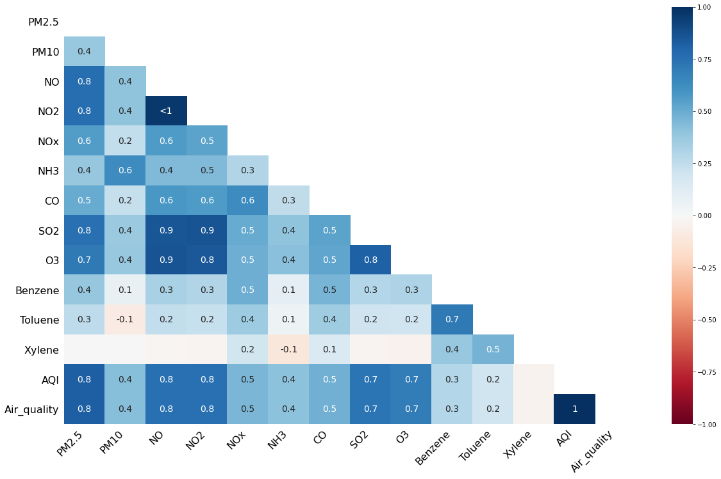
Contd.
Missing Values Heatmap

Slide 27
Contd.
Pollution Content Analysis:
Categorized pollutants into Vehicular and Industrial Pollution.
Created new features: Vehicular Pollution Content and Industrial Pollution Content.
Investigated correlation with Air Quality Index (AQI).
Pre and Post COVID-19:
Segregated data into Pre and Post COVID-19 periods.
Analyzed changes in Vehicular and Industrial Pollution Content.

Slide 28
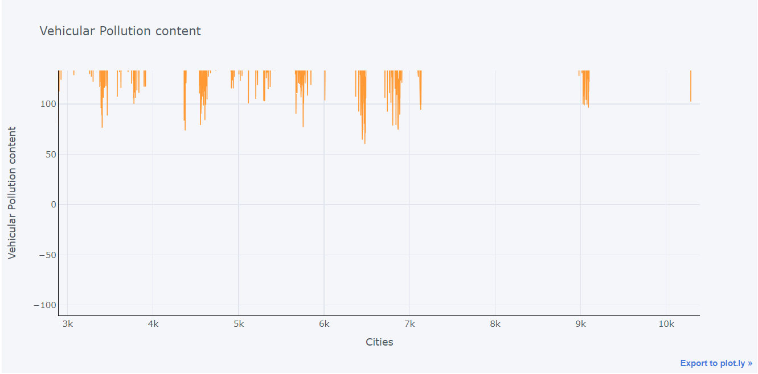
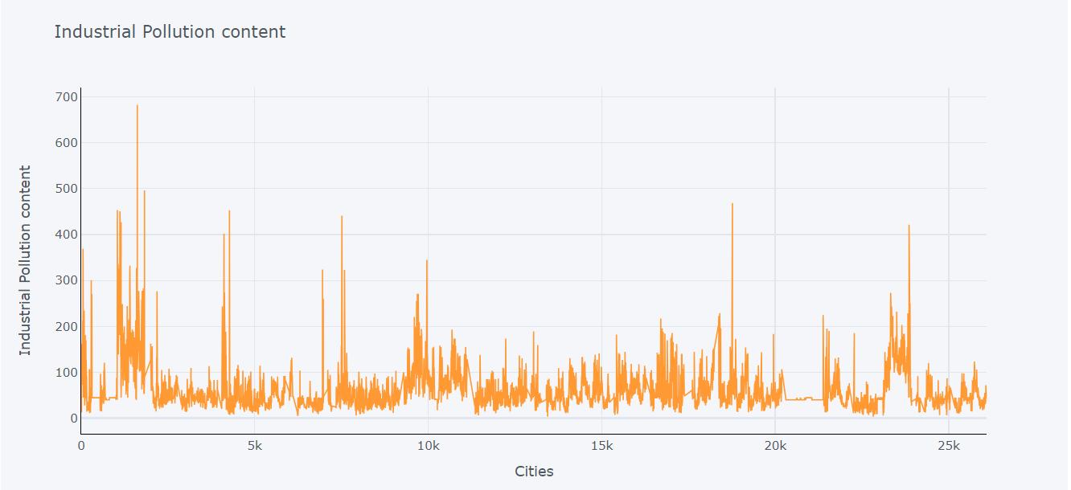
Contd.
Pre-Covid pollution content

Slide 29
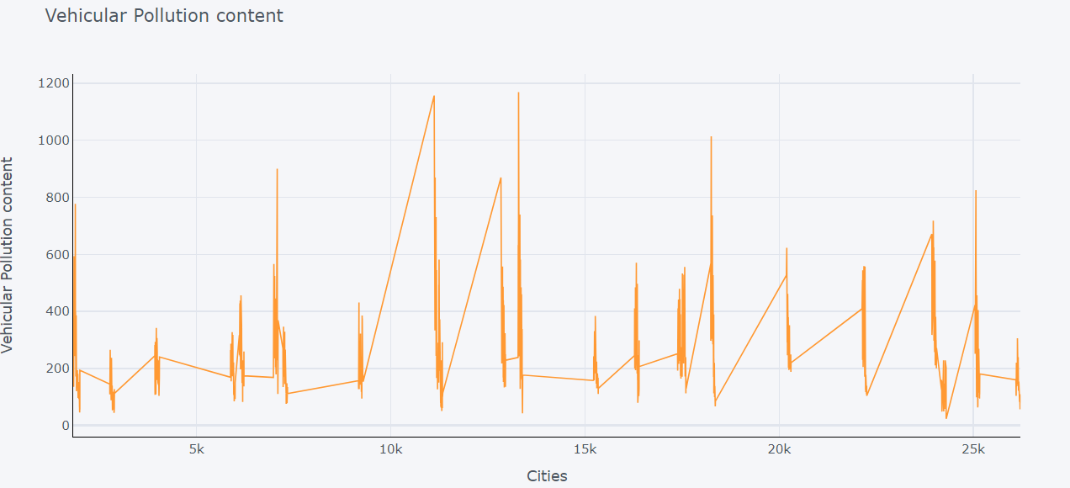
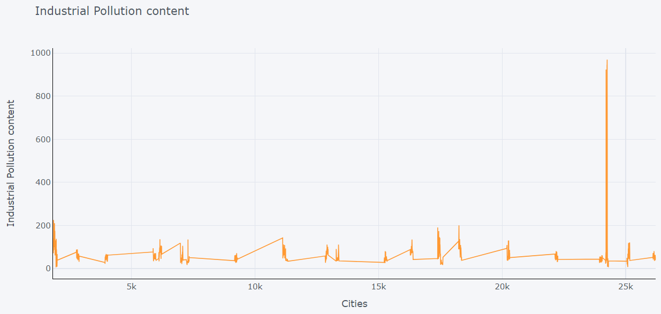
Contd.
Post-Covid pollution content

Slide 30
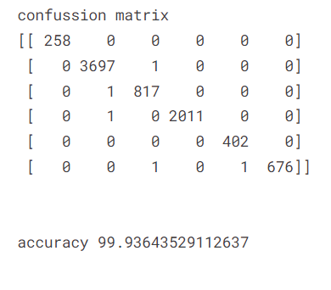
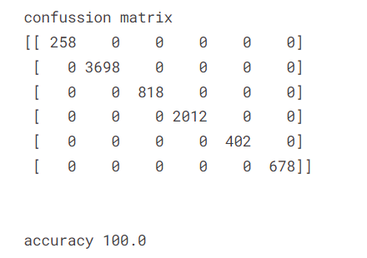
Contd.
Classification Models:
Applied Support Vector Machine, Random Forest, and XGBoost.
Resolved data imbalance using SMOTE.
Random Forest Classifier
Extra Gradient Boost Classifier

Slide 31
Conclusion and Hypothesis Evaluation
Gradual decrease in pollution post-COVID-19.
Extra Gradient Boost Classifier achieves 100% accuracy.
Hypotheses Recap
Hypothesis 1: "A reduction in vehicular pollution content will be observed after the COVID-19 pandemic."
Hypothesis 2: "Industrial pollution content will decrease in major cities post-COVID-19."
Hypothesis 3: "Air quality classification models will reflect a significant impact on accuracy during and after the pandemic.“
Comparison with Findings
Hypothesis 1: The analysis revealed a noticeable decrease in vehicular pollution content post-COVID-19, aligning with the hypothesis.

Slide 32
Conclusion and Hypothesis Evaluation Contd.
Hypothesis 2: Industrial pollution content did exhibit a decline in major cities after the pandemic, supporting the hypothesis.
Hypothesis 3: The classification models, especially the XGBoost classifier, showed remarkable accuracy improvements during and after the pandemic, confirming the hypothesis.
Key Insights
The reduction in vehicular and industrial pollution contents post-COVID-19 indicates a positive environmental impact.
The effectiveness of the XGBoost classifier suggests its suitability for air quality prediction.

Slide 33
Conclusion and Hypothesis Evaluation Contd.
Implications for Air Quality Analysis
These findings emphasize the need for ongoing monitoring and policy adjustments to sustain improvements.
The success of the classification models indicates the potential for data-driven decision-making in air quality management.

Slide 34
Extracting Lessons from the Analysis
Skill Development
Skills honed in data preprocessing, feature engineering, and model evaluation proved crucial.
Proficiency in utilizing advanced machine learning techniques, including XGBoost, was essential.
Data Interpretation
Challenges in interpreting complex air quality data underscored the importance of domain knowledge.
Improved strategies for handling missing data and ensuring data quality were identified.

Slide 35
Extracting Lessons from the Analysis Contd.
Modeling Techniques
Evaluation of multiple models revealed the strengths of the XGBoost classifier in this context.
Continuous learning and adaptation of modeling techniques were crucial for accurate predictions.
Continuous Improvement
The experience highlighted the dynamic nature of air quality analysis, necessitating ongoing skill development.
Emphasis on staying informed about emerging techniques and tools for robust data analysis.

Slide 36
Guiding Future Endeavors
Recommendations for Further Study
Suggest exploring temporal trends in air quality to understand long-term patterns.
Propose investigating the impact of specific interventions on air quality for targeted improvements.
Policy Implications
Advocate for evidence-based policy adjustments to sustain improvements in air quality.
Encourage collaboration with environmental agencies to implement data-driven policies.

Slide 37
Guiding Future Endeavors Contd.
Collaboration Opportunities
Highlight the potential for collaboration with research institutions to expand the scope of analysis.
Stress the importance of interdisciplinary collaboration for comprehensive air quality management.

Slide 38
Thanks!
Do You Have Any Questions?

